Slide 1


Analyzing Accidents Using NHTSA Data
Date: 09 Oct 2024
By Dontireddy Manasa

Slide 2

Table of contents
Problem Statement
Business Understanding
Introduction
Data Generation
Data Collection
Data Processing
Data Storage
Data Management
Data Analysis
Data Visualization
Data Interpretation
Conclusion

Slide 3
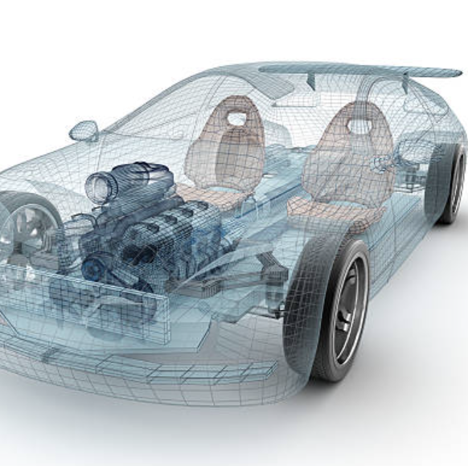
Problem Statement
The Impact of car safety features on lowering deaths, and how do certain vehicle characteristics (make, model, year) correspond with accident outcomes .

Slide 4

Business Understanding
Who – Vehicle Manufacturers, Traffic Safety Experts
Why – Variations in safety features , Quality of design , performance factors that affect reliability, driver protection , vehicles manufacture have impact on the accident rates. Lack of Modern Safety technologies from the models having lower safety ratings increases the frequency of accidents
Purpose – Improve public safety by spotting patterns in vehicular incidents and concentrating on relationships between the attributes of vehicles (model, make, year, and safety ratings) and the frequency of accidents. This helps to uncover vehicle model and manufacture/accidental trends that influence better car safety rules, enlighten customers when making choices, and push manufacturers to prioritize vehicles security precautions that can save lives .

Slide 5

Introduction
This project analyzes road safety by examining accident data from the NHTSA's Fatality Analysis Reporting System (FARS) and vehicle-specific information. It aims to identify correlations between vehicle make and accident severity, ultimately providing insights to enhance safety standards and inform regulatory decisions regarding vehicle safety and accident prevention
In addition, this project analyzes peak accident hours and days, which will help authorities improve traffic rules and safety guidelines to ensure the utmost safety for those traveling on the road.

Slide 6

Data Life Cycle For Accident Analysis
Data Generation
Whenever accidents happen and they are reported to the police department, the raw or unstructured information such as model of vehicle , the location of the incident happened, date and time , operating behavior, and if any injuries are occurred. This accident data is collected and analyzed by the NHTSA’s - National Highway Traffic Safety Administration’s.
Website link - https://www.nhtsa.gov/file-downloads?p=nhtsa/downloads/FARS/
Automobile manufacturers conduct out safety evaluations independently, generating information on the make, model, year, and safety ratings of their vehicles. This vehicle-specific data is also maintained in the NHTSA Open Data Portal repository.
Website link - https://www.nhtsa.gov/nhtsa-datasets-and-apis#ratings

Slide 7
Data Life Cycle For Accident Analysis
Data Collection
Our use case begin by collecting one Static dataset and Streaming Data
Accident Data - The static dataset can be downloaded from the NHTSA website where it contains Year wise Fatality Analysis Reporting System (FARS) data . The FARS provides accidental information among each state such as vehicle kind, the spot , state and driver conduct which will be collected via in this dataset under year wise folder – ‘FARSNationalCSV .The folder contains multiple files where ‘accidents.csv’ and ‘vehicles.csv’ are the important files which contains total of 95,757 records.
Website link - https://static.nhtsa.gov/nhtsa/downloads/FARS/National/FARS
Vehicle-MMY Data - The streaming API is also collected from the same NHTSA website which provides up to date information about the vehicle manufacturing details such as vehicle model , make and its year . This API will be beneficial for linking car attributes to accident data.
Website link - https://www.nhtsa.gov/nhtsa-datasets-and-apis#ratings

Slide 8
Data Life Cycle For Accident Analysis
Data Processing – Open Refine
Once the FARS dataset is downloaded,
The FARS dataset needs to be cleaned and processed to improve analysis by addressing missing values, translating dates forms, and possibly standardizing data related to geography. Open Refine can be used to clean the data.
The Slide-9 has before and after cleaning dataset in Open Refine
Similarly , for the streaming data , first we need to obtain data from the API . Jupiter can be used to get rightful information from the huge data. Slide-11 has the screenshot on how data is pulled using API.

Slide 9
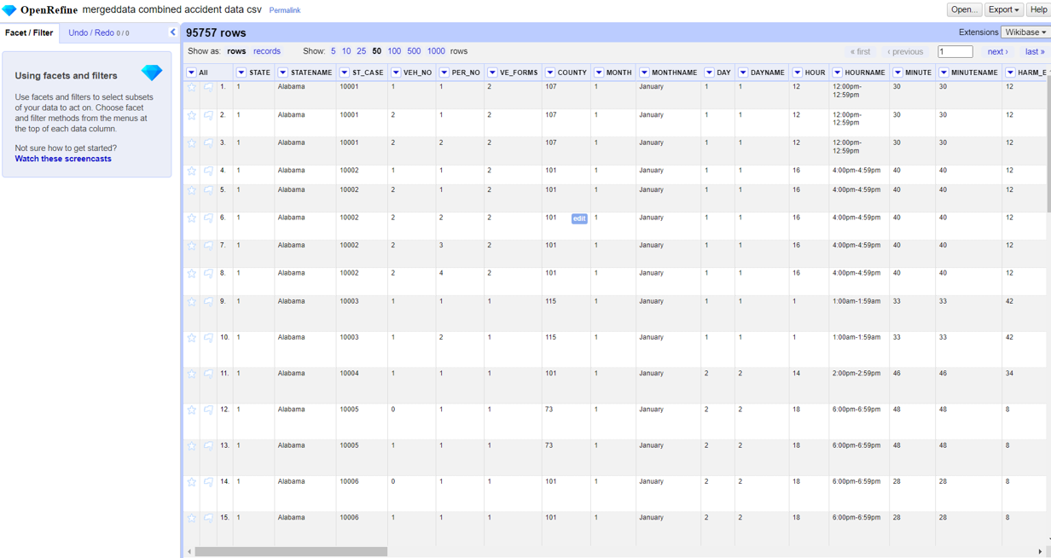
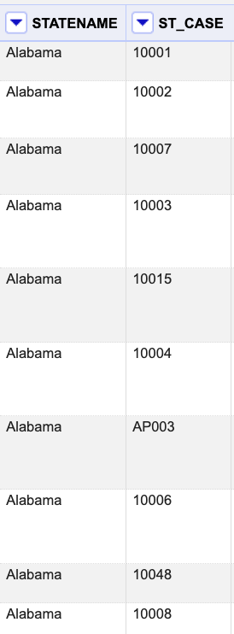
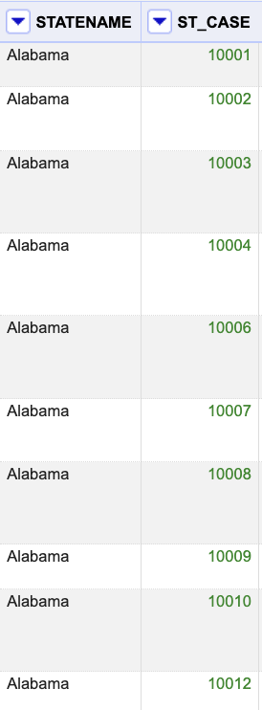
Open Refine – Before and After changes
Strings are present in Numerical primary key – Removed all categorical(AP003) that are present in numerical column
Sorted primary keys (St_Case) into ascending order.
For E.g. : “St_Case” column is cleaned accordingly
Before
Before
After

Slide 10
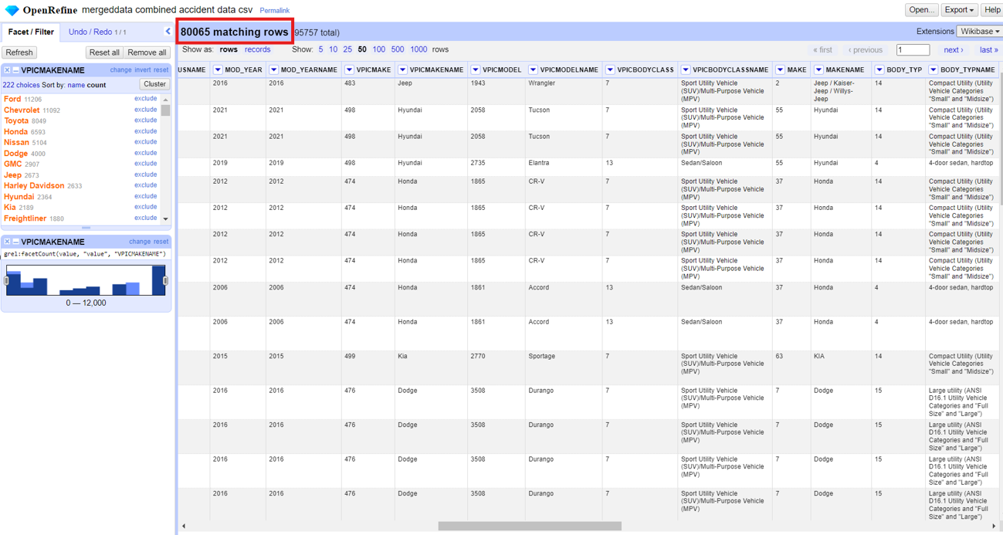
Open Refine – Before and After changes
Cleaned the data by eliminating blanks from the VPICMAKENAME Name column, resulting in a total of 80,065 records remaining.
Before
After

Slide 11
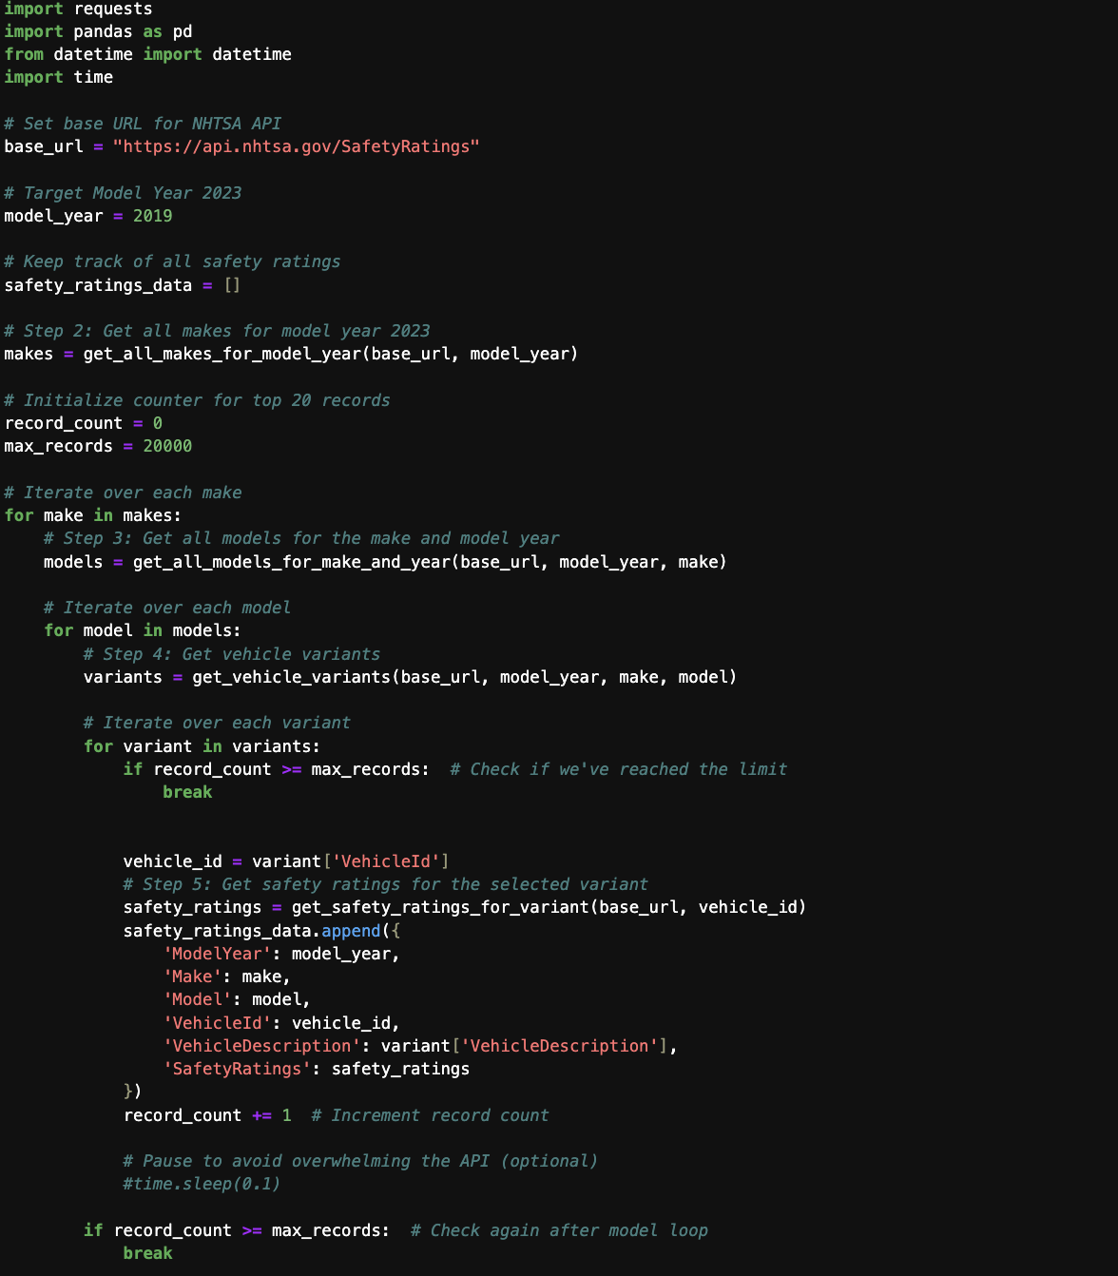
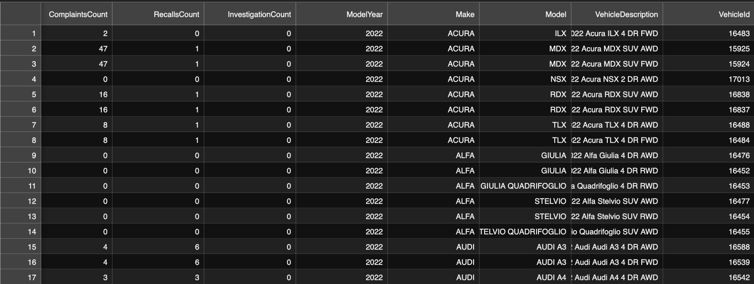
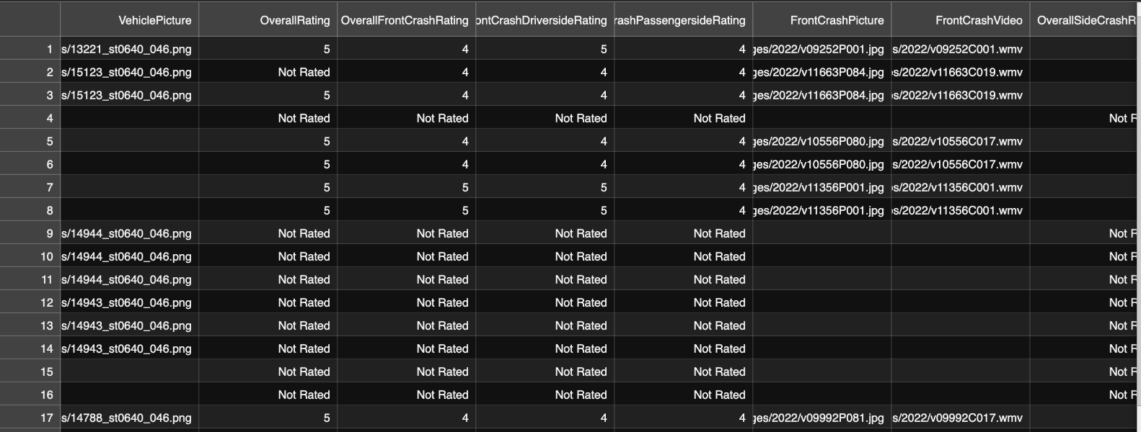
Jupiter code to pull data from API - https://api.nhtsa.gov/SafetyRatings
Sample Code
Results

Slide 12
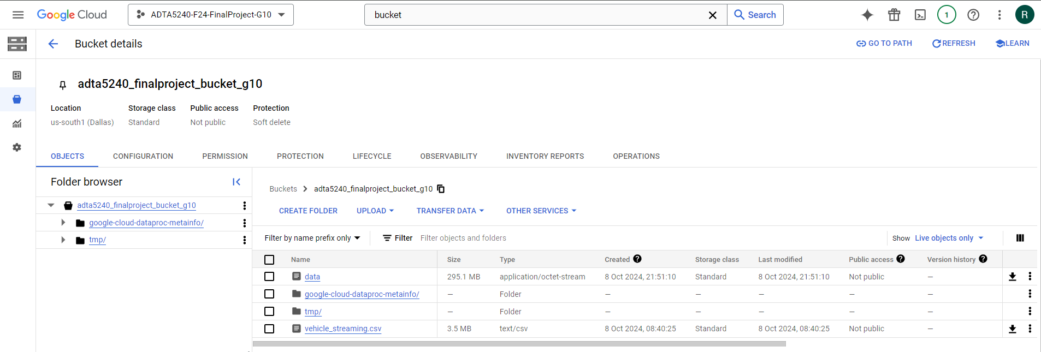
Data Life Cycle For Accident Analysis
Data Storage - GCP
Once the FARS dataset and API is processed , the data is stored in Google Cloud Platform platform (GCP) . A new project has been created under name “ADTA-5240-F24-FinalProject-G10” also respective bucket “adta5240_finalproject_bucket_g10” have been initiated . Also, the vehicle rating , vehicle accidents files and streaming data has been added to the bucket.
Here’s the screenshot

Slide 13
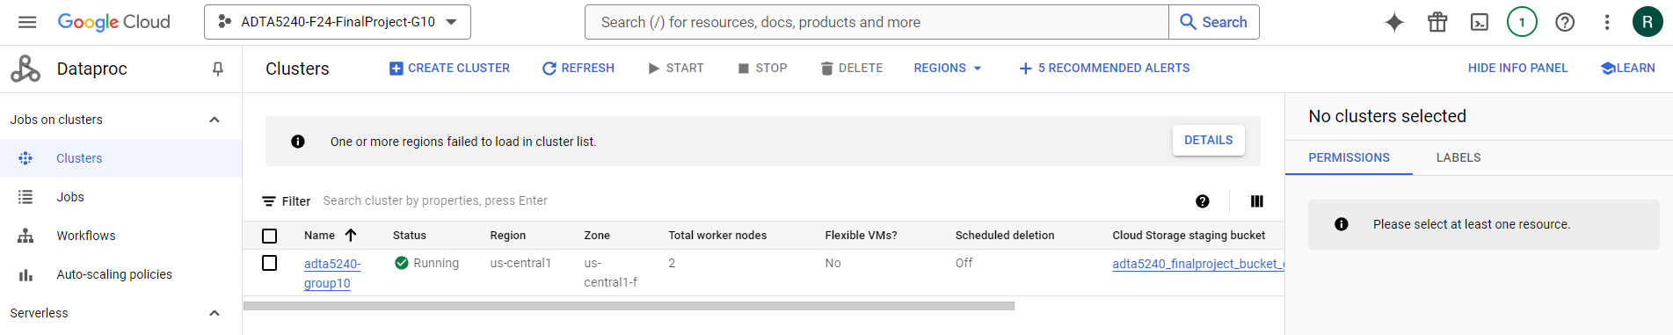
Data Life Cycle For Accident Analysis
Data Management – Hadoop
Once the project and bucket has been created in GCP , now Hadoop Data Proc clusters needs to be implemented to retrieve/query the vehicle safety ratings information from the accident data . Make sure to enable Cloud Data Proc API and Computer Engine in GCP. It helps to manage large amount of data .
Here is the screenshot:

Slide 14
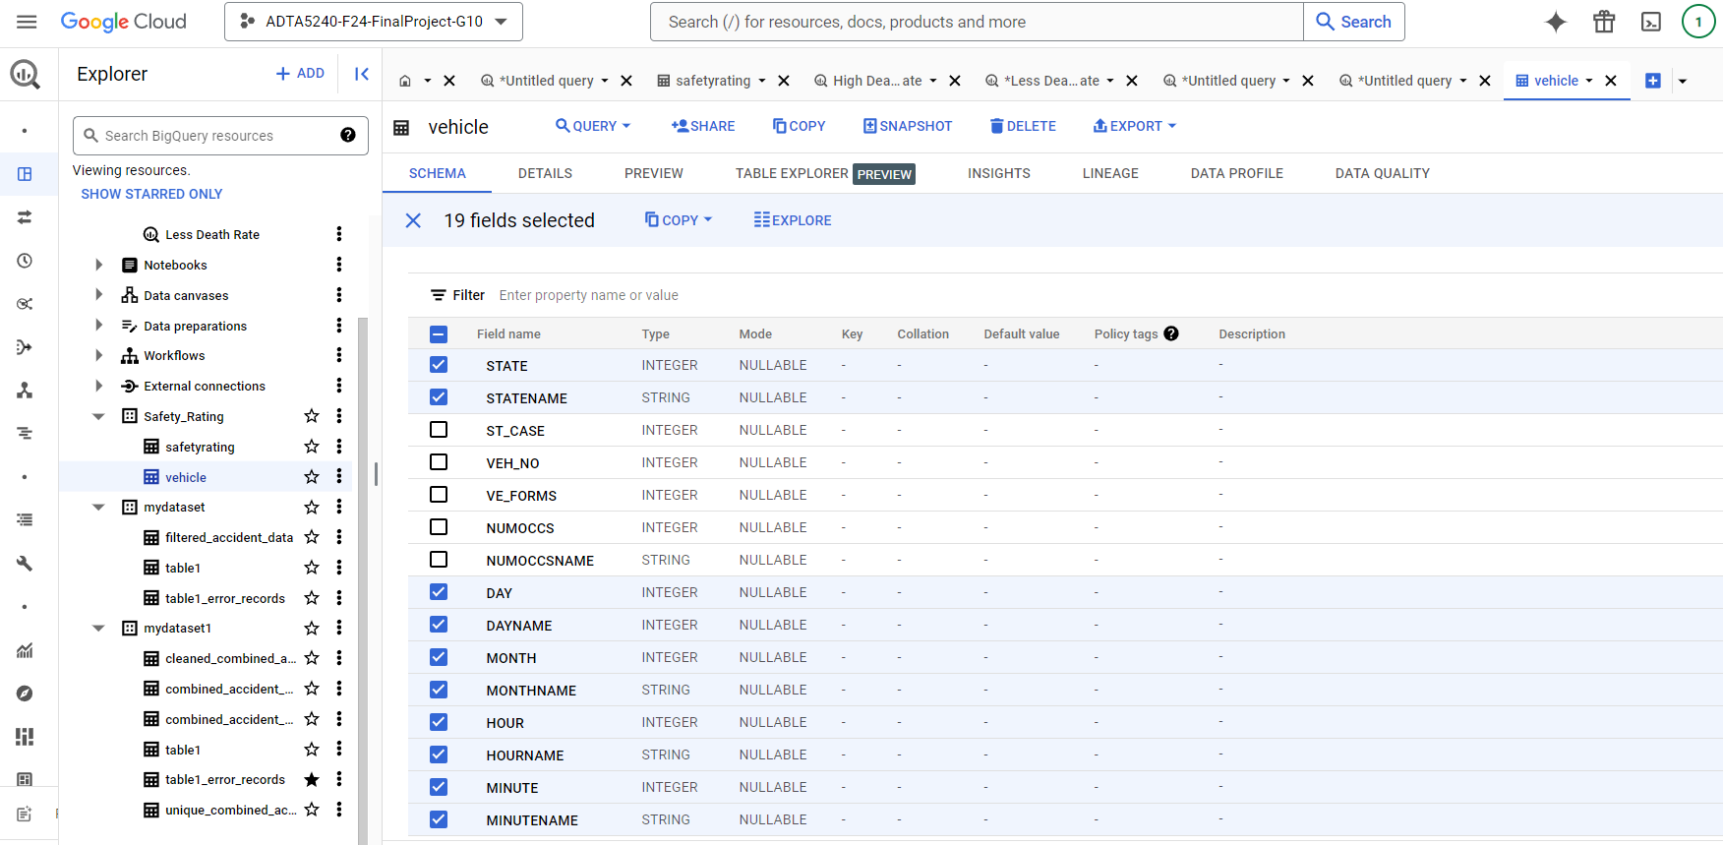
Final merged dataset
The schema show the final combined dataset ready for further analysis

Slide 15
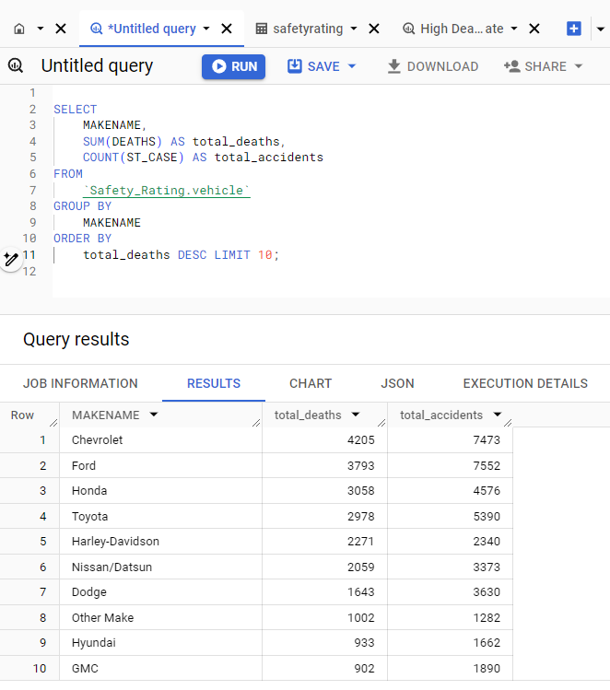
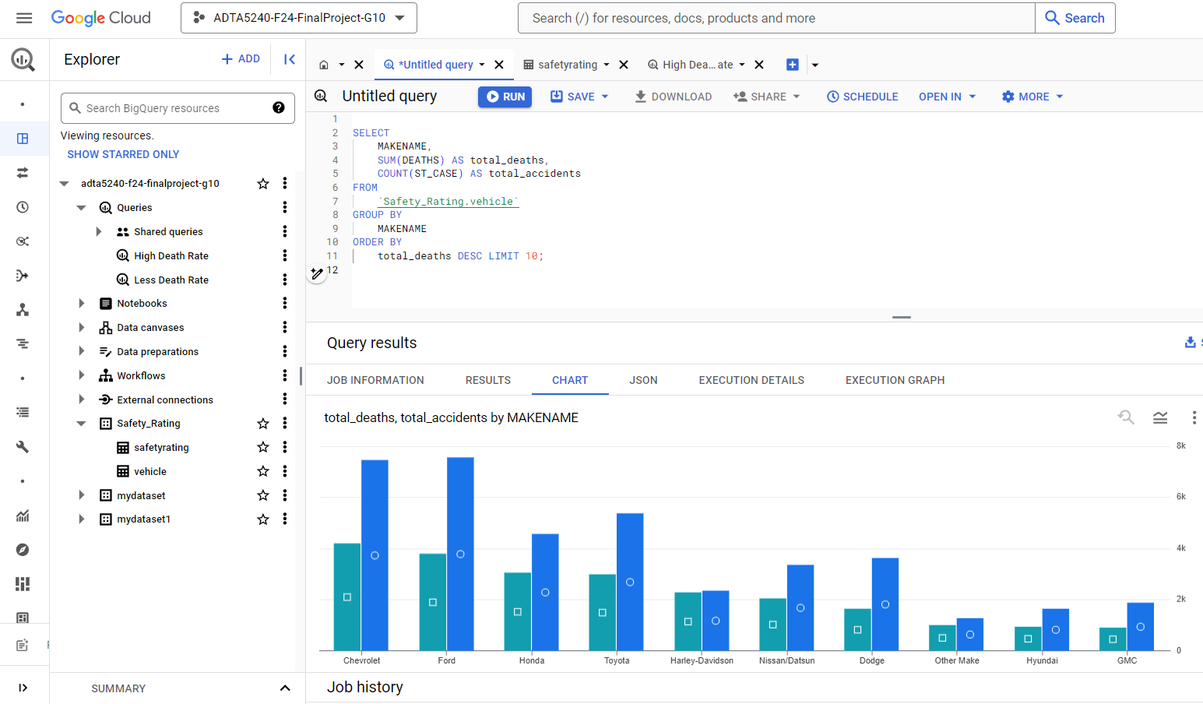
Data Life Cycle For Accident Analysis
Data Analysis
Big Query and visualization graphs have been used to uncover the correlated patterns between vehicle characteristics and the accidental data.
Here’s the conclusion: Top ten vehicle makes with the highest number of accidents and deaths are shown in the below analysis

Slide 16
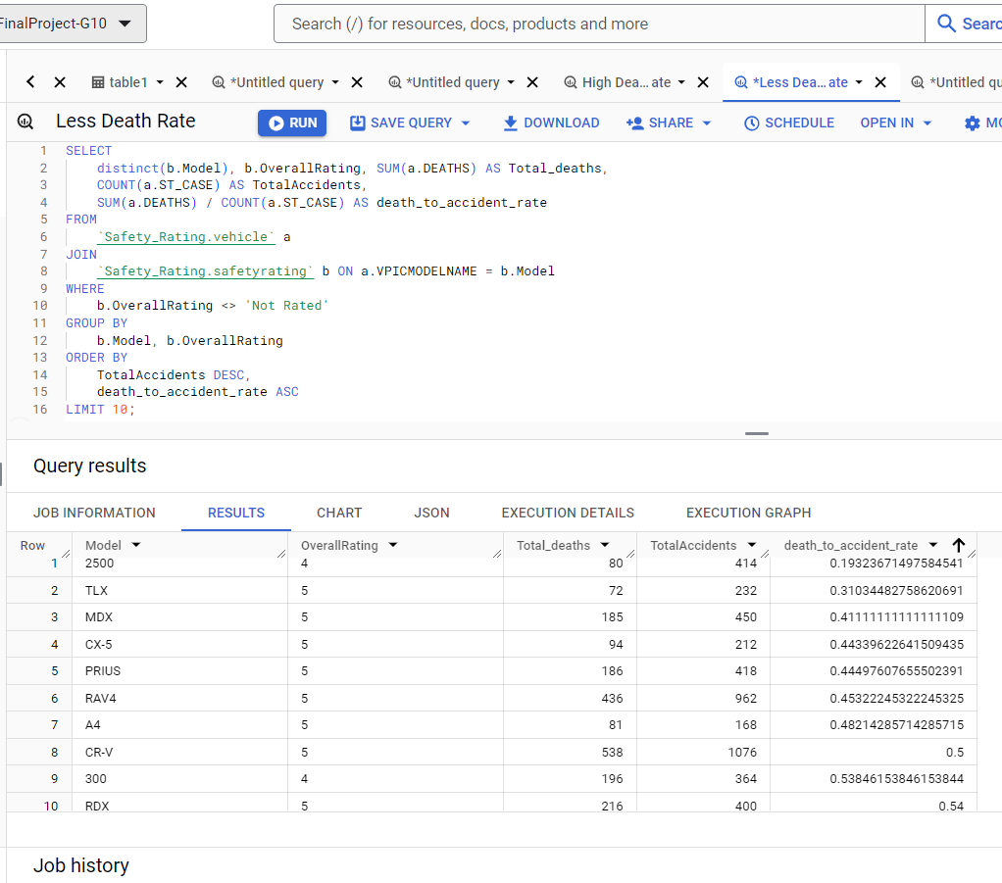
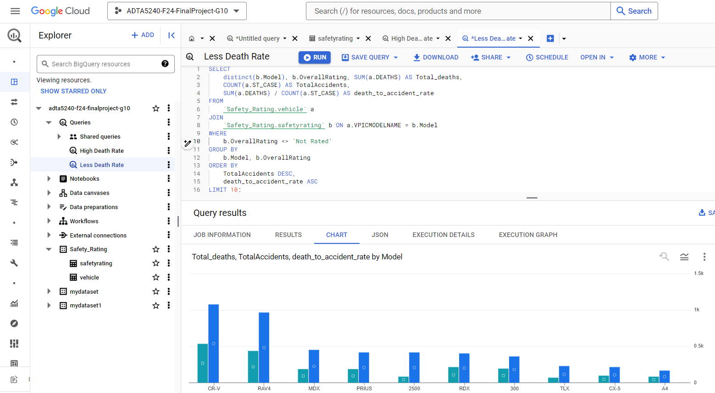
Data Life Cycle For Accident Analysis
Data Analysis
Big Query and visualization graphs have been used to uncover the correlated patterns between vehicle characteristics and the accidental data.
Here’s the conclusion: The analysis aims to highlight that vehicles with the highest number of accidents, specifically those with 4 or 5-star ratings, tend to have a lower likelihood of fatalities. Notably, the RAM 2500 model exhibits the lowest fatality rate at 0.19.

Slide 17
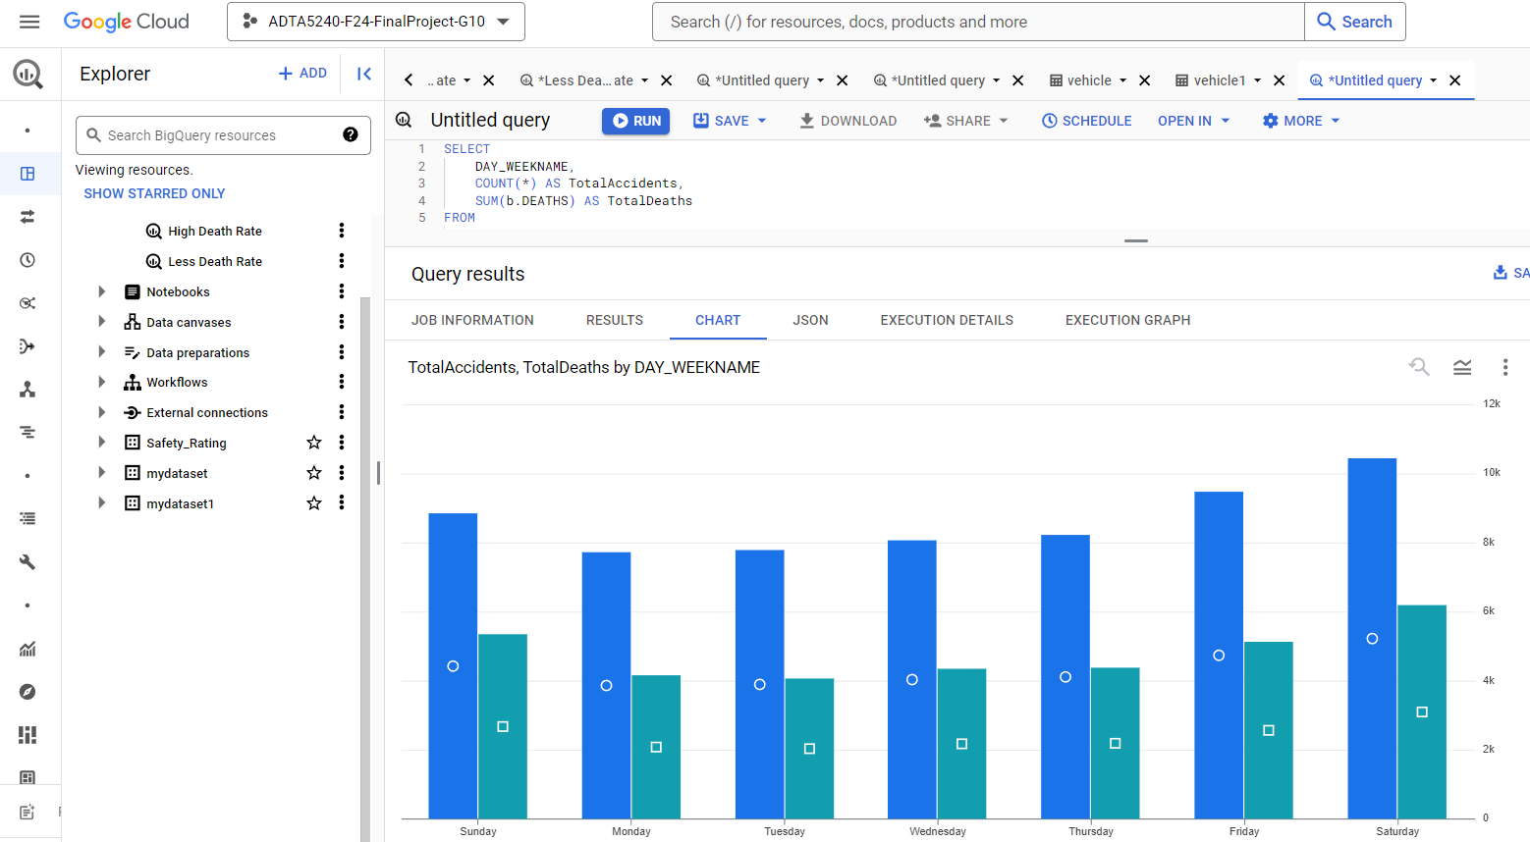
Data Visualization Number of accidents occurred on days of the week
Data Life Cycle For Accident Analysis
Data indicates that weekends, particularly Saturdays, have the highest rates of accidents and fatalities, suggesting an increased risk during leisure time. Generally, weekdays see fewer incidents.

Slide 18
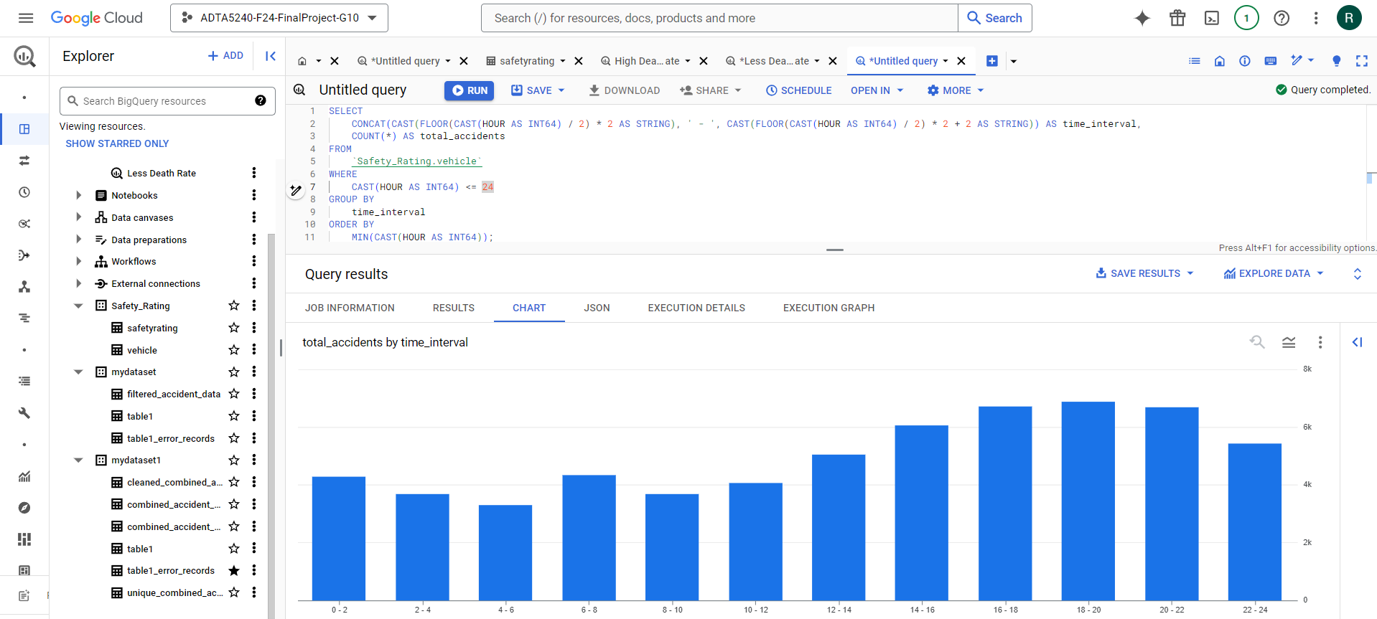
Data Visualization Number of accidents that occurred during each 2-hour interval of the day
Data Life Cycle For Accident Analysis
The data indicates that the highest number of accidents occurs in the evening, especially between 4 PM and 10 PM, with a sum of 28,322 accidents recorded at between 4-10PM.

Slide 19
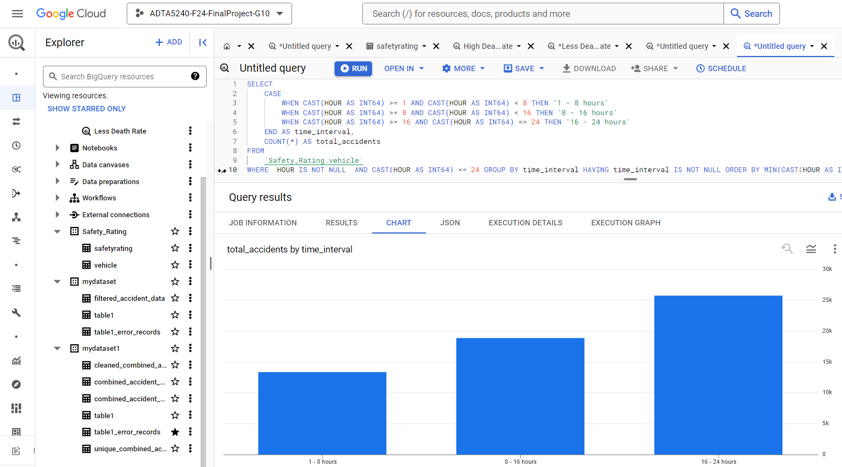
Data Visualization Total accidents based on time of the day
Data Life Cycle For Accident Analysis
Accidents occurring during 04-12PM traffic hours are notably higher than remaining hours of the day. Off-peak hours are linked to a greater number of injuries and fatalities compared to accidents that take place during rush hours.

Slide 20
From the analysis and visualizations, it is clear that the fatality rate can be significantly reduced by using vehicles with high safety ratings (4 or 5 stars) for transportation. We have also extracted data on the vehicle makes that are involved in the most accidents and their associated fatality rates. This analysis highlights the importance of considering safety ratings when the public plans to purchase a new vehicle.
Data Life Cycle For Accident Analysis
Data Interpretation
In addition to the above, we have analyzed busy traffic days and hours, identifying weekends and the period from 4 PM to 12 AM as the times with the highest fatality rates. This insight enables authorities to enhance safety measures during these peak periods and informs the implementation of additional infrastructure projects to improve road safety.

Slide 21
We have conducted a thorough analysis of the NHTSA datasets, uncovering various insights related to vehicle types, accident timing, and severity. Our findings indicate that certain vehicles and types are more frequently linked to severe accidents, with fatalities and incidents occurring more often on weekends, particularly on Saturdays. Additionally, the highest traffic volume is observed between 4 PM and 12 AM, highlighting a strong correlation between accidents and fatality rates. This analysis emphasizes the need for targeted safety measures during high-risk periods such as weekends and rush hours, as well as the necessity to improve vehicle safety standards, which have significantly contributed to the reduction in fatalities. Understanding these trends can inform future safety regulations and enhance public awareness regarding accident prevention and vehicle safety.
Conclusion

Slide 22
The end

